Slide 1
Plant leaf Disease detection Using CNN and TensorFlow(Phytora: Plant Health’s Future)
- BY Team SALAAR

Slide 2
Table of Contents
Team Members Roles and Responsibilities
Problem Statement
Project Description
Persons
Technologies
Project Schedule
Retrospective
Team Agreement
Wiki Link

Slide 3
Problem Statement
Plant diseases create significant reductions in agricultural productivity; such losses result in crop failure, financial loss for the farmers, and even food shortages. Traditional methods of disease identification involve manual inspections and laboratory tests, which are very time-consuming, expensive, and inaccurate.
Challenges Faced by Farmers: Delayed Disease Detection → Results in huge losses in crops. High Costs of Lab Testing → Early intervention difficult. Excessive Use of Pesticides → Unnecessary expenses and environmental degradation. Manual Tests → Require professional knowledge and trained labor.

Slide 4
Project Description
Project Name: | Plant leaf Disease detection Using CNN and TensorFlow
Team: | SALAAR
Project Description: | Project helps the farmers to decide the better pesticide to be used for the farm with some clear and concise analysis done By Us For farmers and agriculturalists who face the hurdle of distinguishing and accessing treatment for plant leaf pathogens, the plant leaf disease detection application is a plant bug detection tool powered by machine learning that detects and categorically diagnoses plant ailments from leaf photographs. Unlike traditional inspection methods or straightforward image analyzing mobile applications, our application offers the means to provide a broader plant disease diagnostic scope, resulting in faster actions and enabling users to take action more effectively rather than protecting crops.
Benefit Outcomes: | Accelerated Disease Detection – Farmers can now easily and accurately diagnose plant-related diseases that are harmful to their crops within seconds. This means less time spent on manual checking and lots more time saved while waiting for lab reports. Increased Profits – Farmers can decrease crop losses by spending less time identifying and treating diseases, which results in less damage and more profitable harvests. Reduced Costs – Treating diseases effectively can be achieved through correct and early identifying disease detection which helps in utilizing less pesticide and saves money. Higher Resource Management – More precise disease detection means that resources such as water, fertilizers and pesticides can be more efficiently distributed, improving farm management systems. Better Yield Resilience – With effective intervention, plants thrive and produce better crops that are not easily damaged and are more tough against diseases. Managed Scale Development – Users can expand their cultivation or apply to different fields due to minimal difficulties and the android’s ability to examine a large range of crops and diseases. Insight from Data – Farmers can receive accurate information on the trends of their crops due to the app collecting, storing and analyzing data over time which helps them to make better decisions about the crops they grow in the future. Less Reliance on Labor – Because of the automated disease detection, there is less need for trained workers during the farming process, which streamlines the farming process.
Github Link: | https://github.com/htmw/2025S-SALAAR/wiki

Slide 5
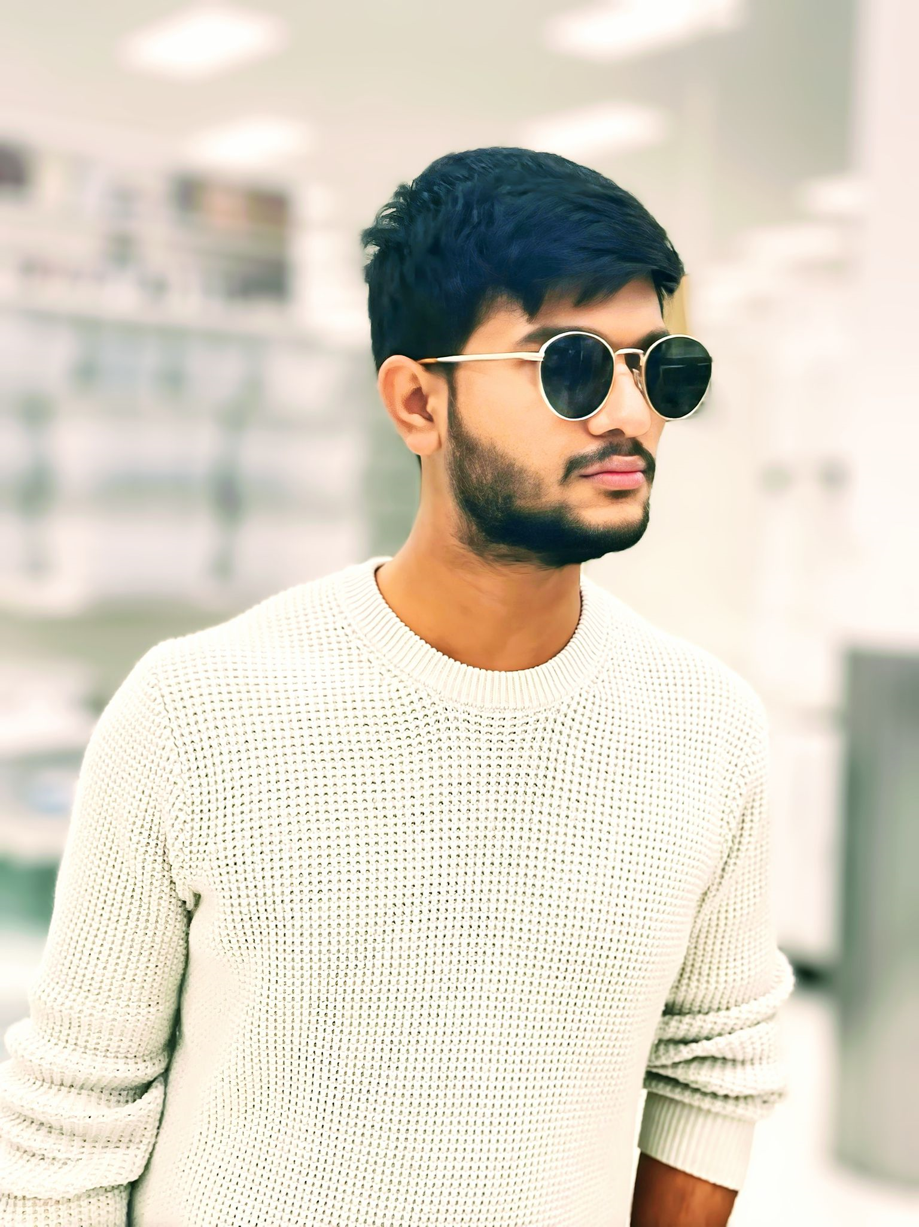
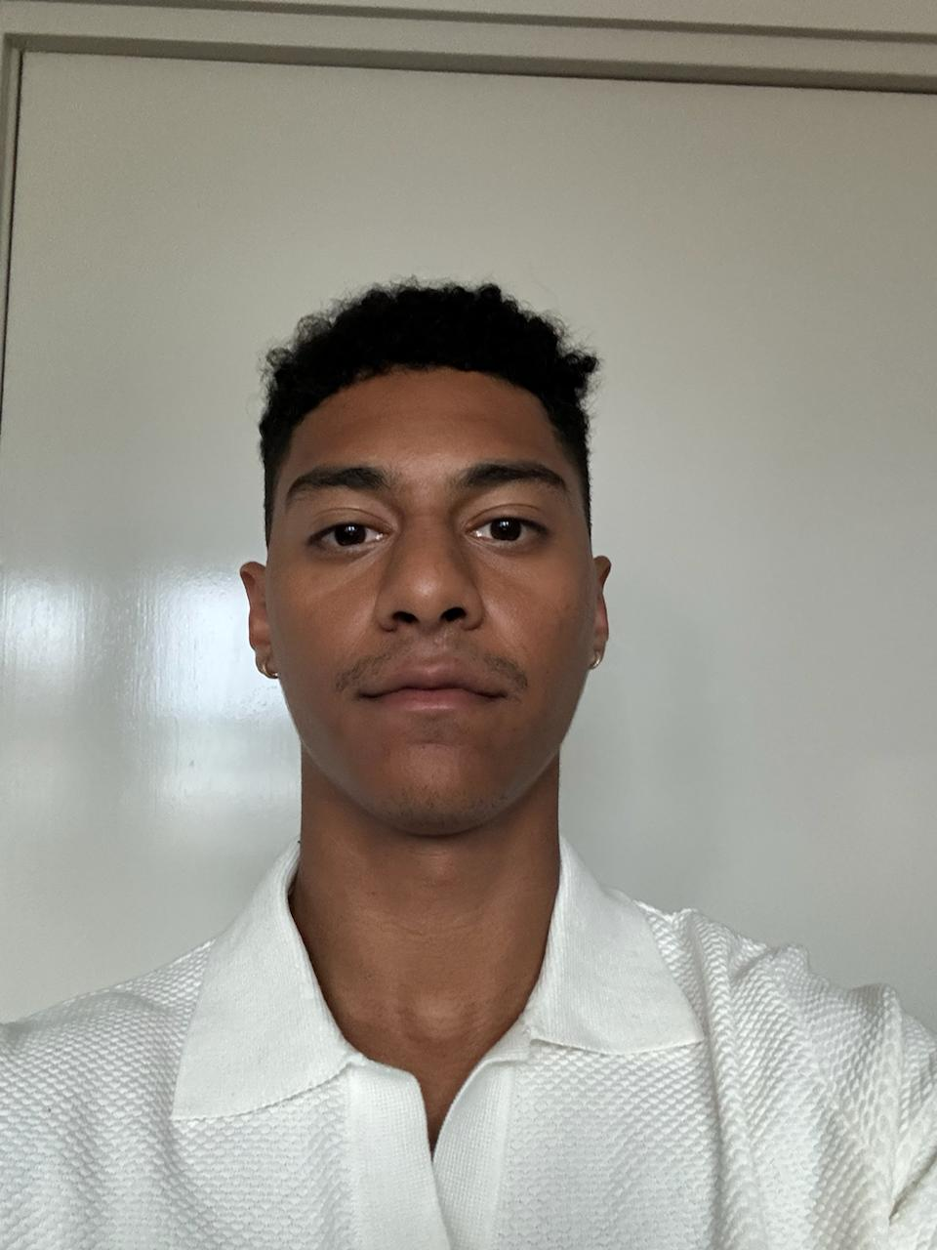
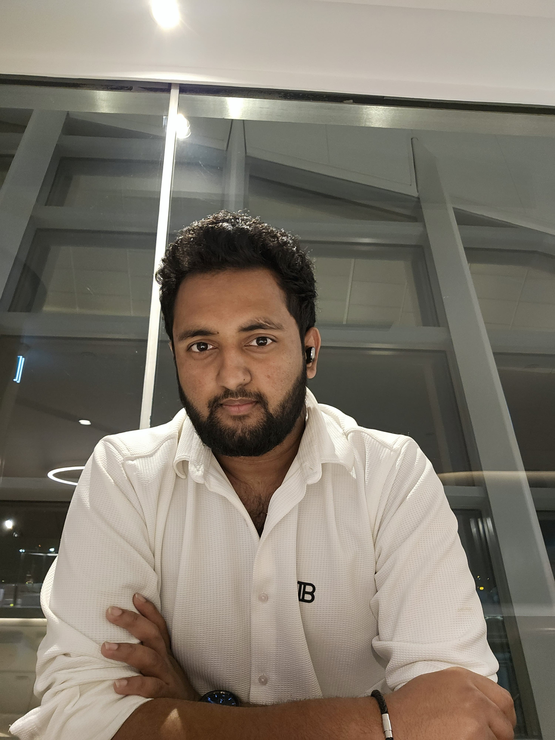
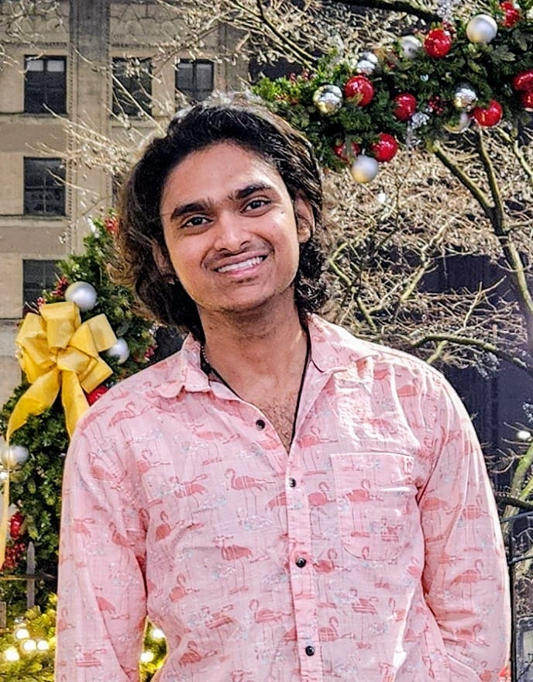
Team Members Roles and Responsibilities
Manoj Reddy Scrum Master
Paul Sr. Front End Developer
Krishna Kishore
Sr. Back End Developer & Team Lead
Gopi Krishna
Jr. Back End Developer

Slide 6
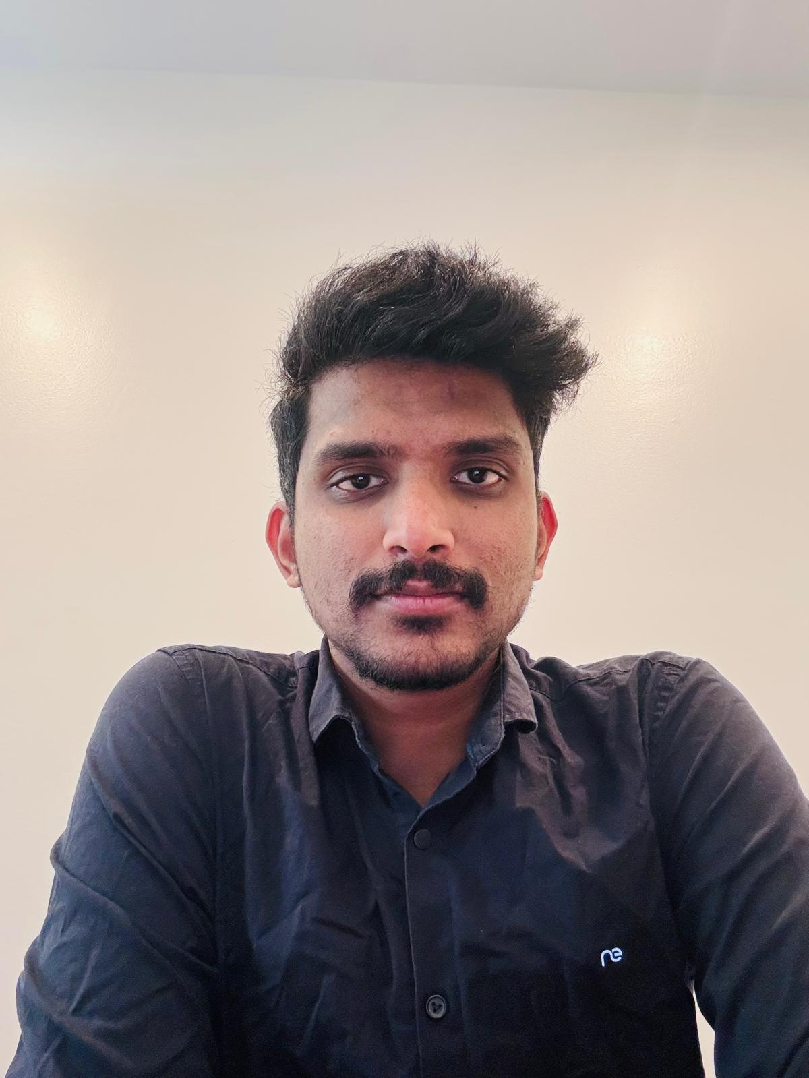
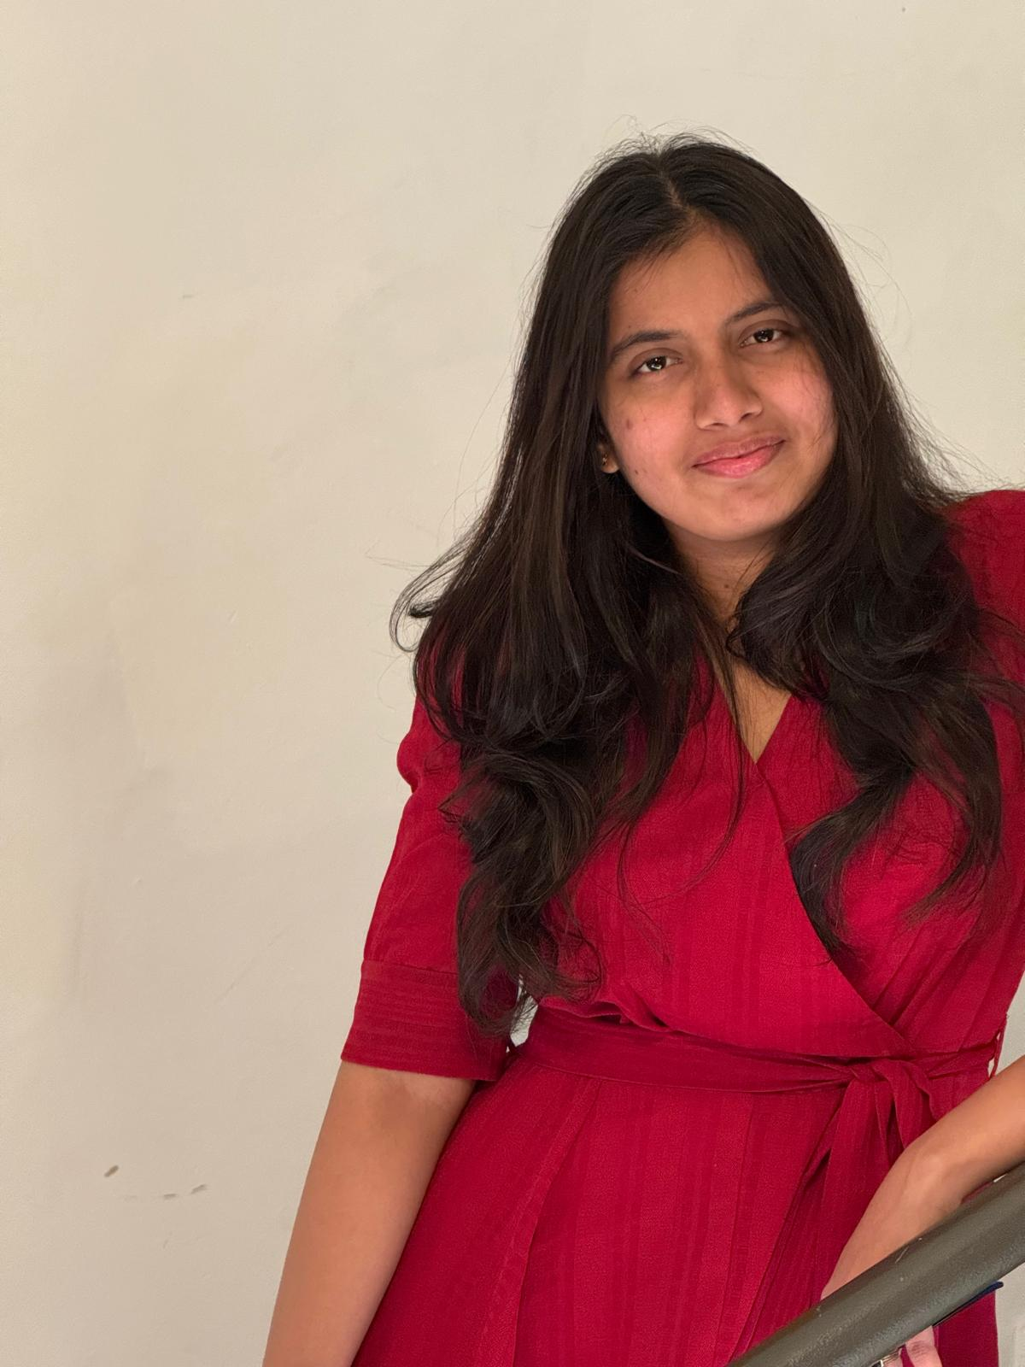
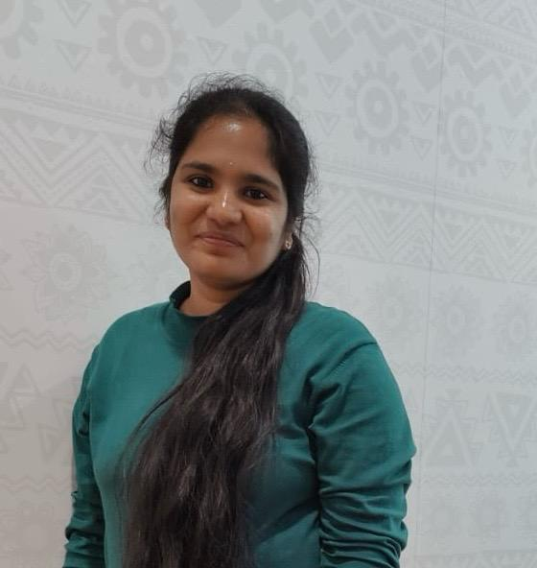
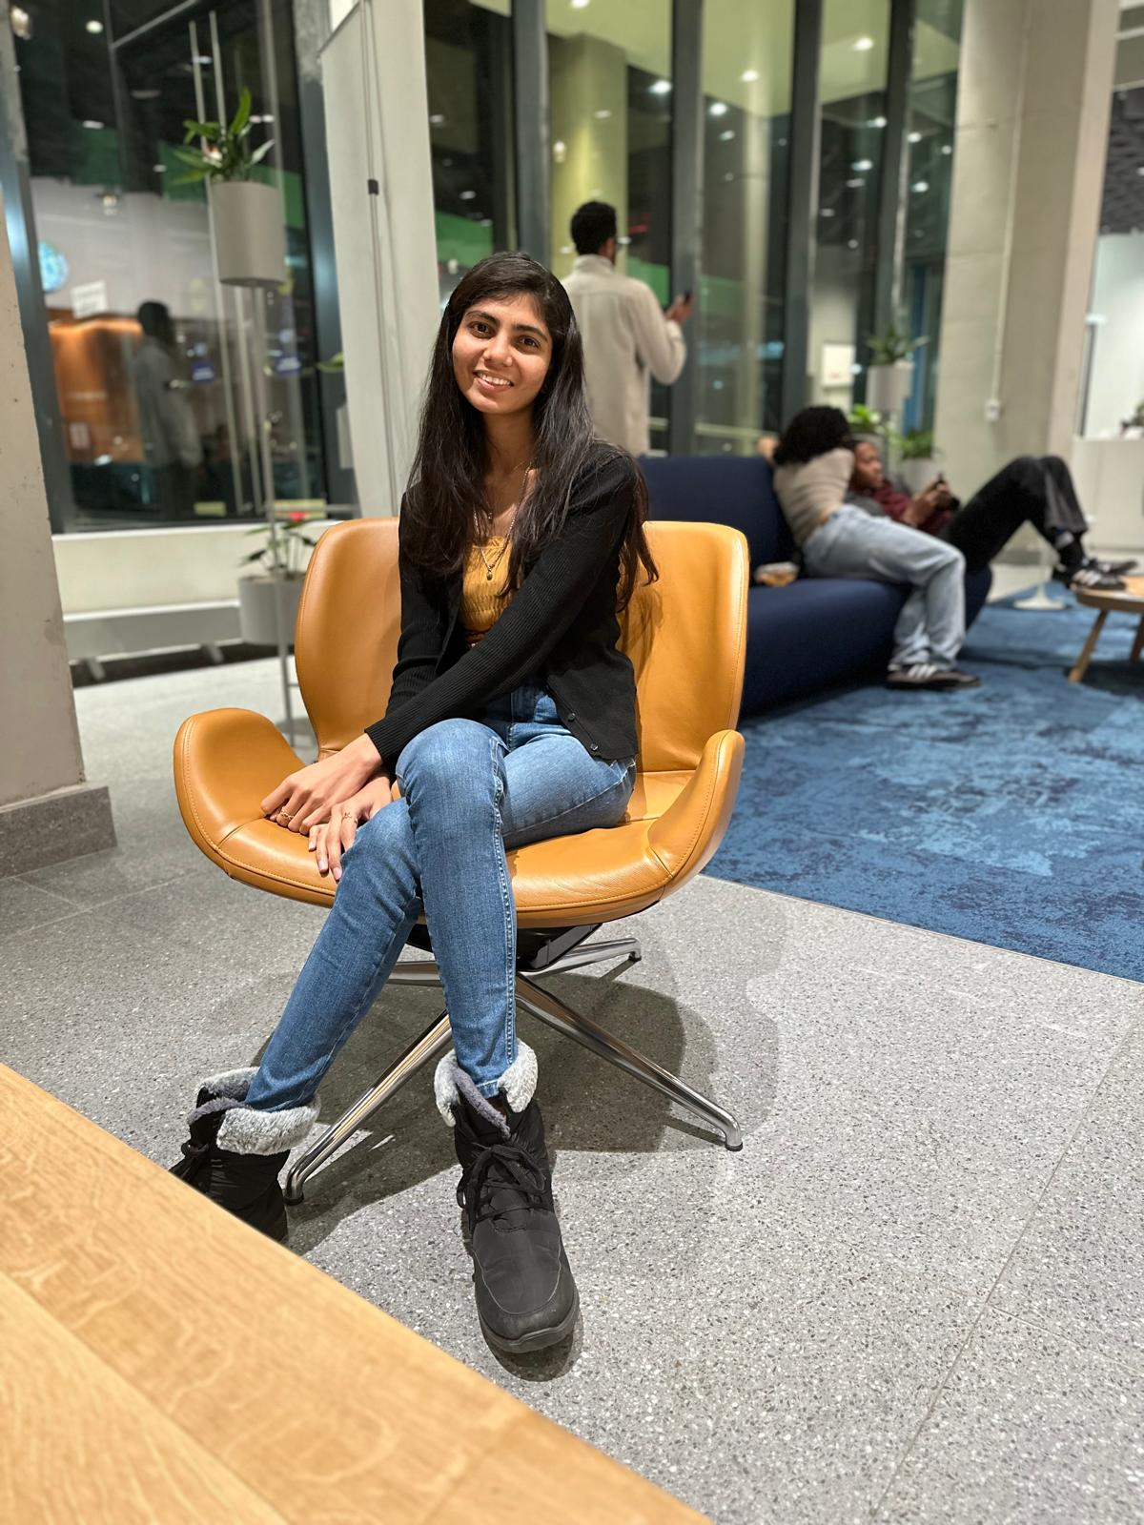
Karthik Back End QA
Sai Priya
Front End
Team Lead
Nikitha Frond-End QA
NagaLakshmi
Jr. Front End Developer

Slide 7

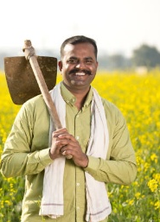
PERSONAS
Farmer – Rajesh Kumar
Age: 45
Location: Andhra Pradesh, India
Background: Rajesh has a 5-acre farm and grows wheat and paddy. He faces problems with plant diseases but doesn't have access to the latest technology in agriculture.
Needs: A simple mobile solution for plant disease identification and treatment.
Challenges:
Limited access to lab testing.
Lack of technical knowledge in AI-based tool usage.
Requires an offline mode when working in the field remotely.

Slide 8
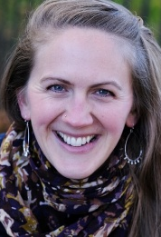
Agricultural Consultant – ED. Anna Mule
Age: 32
Location: New york, USA
Background: Anna is an agronomist with an experience of more than 12 years. She consults for multiple farms and promotes organic and sustainable farming and Director of Slow food USA.
Needs: A scalable diagnostic tool to assess multiple farms and suggest treatment strategies.
Challenges:
Manual inspections take too much time.
Needs high-accuracy AI predictions.
Prefers a web-based dashboard to analyze disease trends.

Slide 9
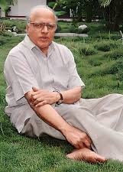
Government Researcher – Dr. Mankombu Sambasivan Swaminathan
Age: 78
Location: Chennai, India
Background: Swaminathan is a government agricultural researcher working on food security and disease prediction models. He works with ICAR and policymakers. https://en.wikipedia.org/wiki/M._S._Swaminathan
Needs: Large-scale data of plant diseases for scientific research & policy making.
Challenges:
Wants real-time data across multiple states.
Disease trend analytics along with historical data.
API preference for data to integrate into projects.

Slide 10




Tools & Technologies
TensorFlow is a software library for
machine learning and
artificial intelligence.
https://www.tensorflow.org/
.
A versatile, high-level programming language.
https://www.python.org/
Tensor Flow
Python
Scikit-learn is probably the most useful
library for machine learning in Python.
https://scikit-learn.org/stable/
Streamlit For building interactive
web applications. https://streamlit.io/
Scikit
Stream lit

Slide 11




Cont..
Visual Studio Code for
Development
https://code.visualstudio.com
Jira for project management and issue tracking
https://www.atlassian.com
VS Code
Jira
Anaconda for Python-based machine learning IDE
https://www.anaconda.com/
My SQL Cluster enables users to meet the database challenges of next generation https://www.mysql.com/
Anaconda

Slide 12


Cont..
Allows developers to create, store, manage, and share their code
https://github.com/
Working together is easier
with Microsoft Teams
https://www.microsoft.com/en-us/microsoft-teams/group-chat-software

Slide 13
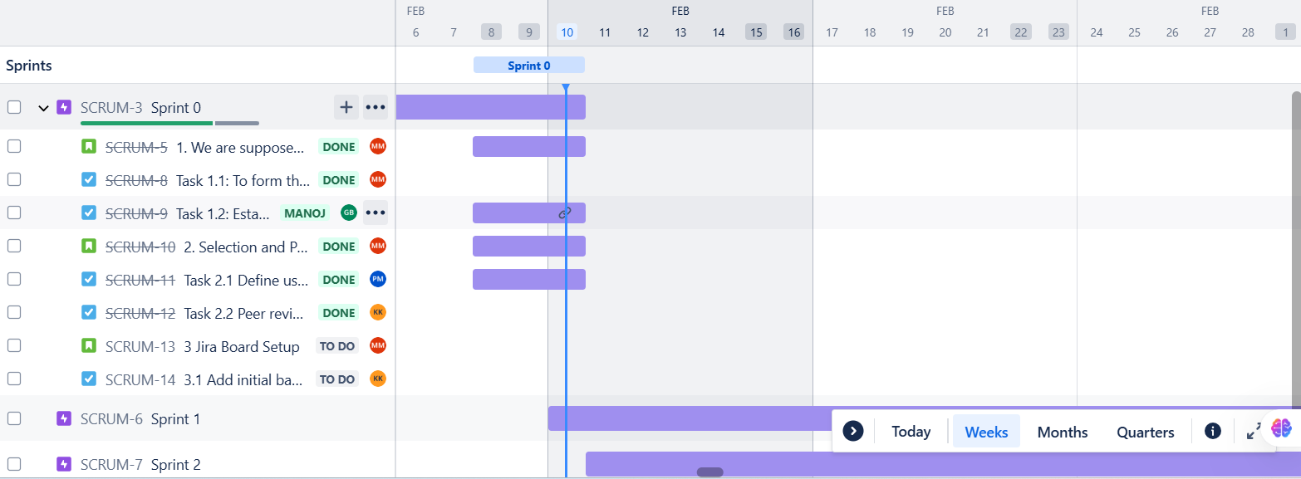
Project Schedule

Slide 14
Retrospective
What Went Well?
Team Formation & Role Clarity
Manoj - Scrum Master - Organized roles in the team.
Sai Priya Frontend Lead & Krishna Kishore Backend Lead - Smooth Coordination
Jira & Git Setup Completed
Manoj - Set up Jira with backlog items.
Paul & Naga Lakshmi (Frontend), Krishna Kishore & Gopi Krishna (Backend) - Set up the Git repository.
Daily Scrum Calls Established
10:00 PM calls were initiated. Most of the team members updated about the progress in Jira before the meeting.
Project & Personas Finalized
Sai Priya added Farmer and Agricultural Expert personas in Jira.
Presentation Video Created & Uploaded
Sai Priya and Arpula Nikitha - Frontend QA designed the video.
Paul and Karthik - Backend QA uploaded and checked it on Git.

Slide 15
Cont..
Areas of Improvement
Jira Task Clarity
Some tasks were too broad and needed better breakdown.
Action: Manoj and Sai Priya will refine task definitions in Sprint 1.
Delayed Peer Reviews
Some pull requests were not reviewed on time.
Action: Arpula Nikitha and Karthik will enforce 24-hour review deadlines.
Git Collaboration Issues
Merge conflicts occurred due to an unclear branching strategy.
Action: Paul and Krishna Kishore will create a Git workflow guide.
Scrum Call Participation
Gopi Krishna and Naga lakshmi have forgotten to update Jira before certain calls.
Action: The members should update Jira before 9.30 PM daily.
Presentation Video Quality
More structure of script required before recording.
Action: The content would be reviewed before recording by Sai Priya and Paul.

Slide 16
Sprint 1 Action Plan
Smoothen Jira Workflow
Manoj and Sai Priya will ensure tasks are well-defined with clear acceptance criteria.
Standardize Git Workflow
Paul and Krishna Kishore will document the branching strategy: main → dev → feature-branch.
Increase Scrum Discipline
Manoj will enforce 15-minute standups.
Gopi Krishna All developers and QA members will update Jira before 9:30 PM.
Enforce Deadlines for Peer Review
Arpula Nikitha and Karthik will ensure pull requests are reviewed within 24 hours.
Improve Video and Documentation
Paul and Sai Priya will do a review before the videos go up.
Clearly, this retro summary encapsulates the essence of Sprint 0 and helps refine the execution at Sprint Please suggest any modification…..?

Slide 17
Team Agreement
Plant Leaf Disease Detection Team Agreement.docx

Slide 18
Wiki Page
SALAAR TEAM WIKI PAGE LINK

